Slide 1
Virtual Experiments
LaMnO3 sample: adding all contributions
E. Farhi, ILL

Slide 2

Our goal
Model a ToF with a LaMnO3 sample
This material has contributions:
  Structure (Bragg peaks)
  Phonons
  Spin-waves
  Incoherent scattering
We shall prepare all this and actually assemble a full model.
Dropbox: 28th: VE LaMnO3

Slide 3
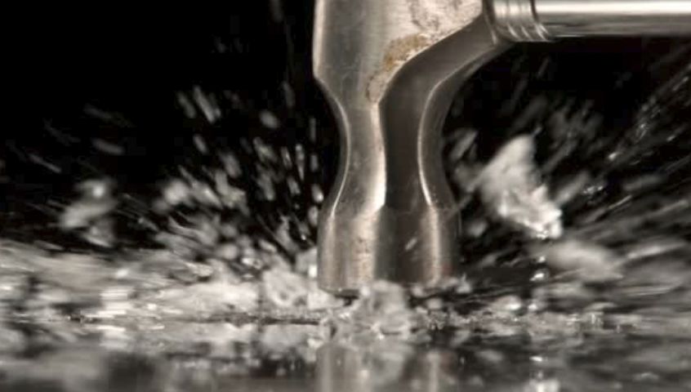
Limitations
We shall use a simple ToF direct spectrometer.
The sample will be assumed in powder state.
The intensity of the contributions will have to be scaled with the proper cross sections. Will not be absolute.
No phonon-spinon coupling as contributions are computed separately.
Antiferromagnet, with localized coupling (BZ boundary).

Slide 4
iFit: data sets
iData
iData_Sqw2D
iData_Sab
iData_vDOS
Import a data file:
  data = iData(‘filename’) % many formats
  data = iData(x,y,z,…, signal)
Convert to a flavour:
  data = iData_Sqw2D(data)
Can apply many operators between data sets
  +-/* trigo … 193 operators.
http://ifit.mccode.orgs

Slide 5
iFit: models
iFunc
iFunc_Sqw2D
iFunc_Sqw4D
iFunc_McCode
Create a model:
  model = iFunc(‘p(1)*x+p(2)’)
  model = gauss
Convert to a flavour:
  model = iFunc_Sqw2D(model)
Can apply many operators between models
  +-/* trigo … 81 operators.

Slide 6
iFit: predefined models
Predefined models: 57
  [o,m] = fits(iFunc) % optimizers, models
  doc(iFunc, ‘Models’)
Those we shall use here:
  sqw_phonons: S(q,w) 4D lattice dynamics / DFT
  sqw_spinwave: SPINWAVE model

Slide 7
sqw_phonons
Uses transparently ASE+PhonoPy to compute lattice dynamics estimate of the Forces in a SX.
Produces a 4D S(q,w) model [iFunc_Sqw4D]
Supports all ASE calculators, e.g. QE VASP …
For complex crystals, computation can be days.
iFunc Sqw4D flavour methods:
  vDOS, thermochemistry, plotting, powder average, ...

Slide 8
sqw_phonons (2)
Will use MPI and all CPU’s
Can input CIF/PDB/… file, as well as common ASE Atom builder (python)
Can also input a ‘cod: formula’
Syntax: sqw_phonons(‘crystal’,’calculator’, …)
  sqw_phonons(‘Al.cif’,’qe’)
  sqw_phonons(‘cod: Al’,’vasp’)
  sqw_phonons(‘bulk("Al", "fcc", a=4.05)’,’gpaw’)

Slide 9
Exercise 1: sqw_phonons Al
Generate the ‘default’ Al S(q,w) model:
  Al = sqw_phonons(‘bulk("Al", "fcc", a=4.05)’,’emt’)
Plot the dispersion and the BZ cube
  plot(Al) % dispersion and DOS
  plot3(Al) % 3D cube
  slice(Al) % play with isosurface and cuts
The views have contextual menus on figure, axis and plots.

Slide 10
sqw_spinwave
Uses transparently SPINWAVE.
Has a special ‘powder’ mode (that we shall use).
Can define variable model parameters $par
Produces a 2D/4D S(q,w) model [iFunc_Sqw2/4D].
  sqw_spinwave(‘file’)
  sqw_spinwave(‘file’,’powder’)
  sqw_spinwave(‘file’,’edit’) % then insert $par, e.g. J1...

Slide 11
LaMnO3: Structure
Just need to generate a LAZY/PulverX Laz file
Matlab/iFit:
  cif2hkl(‘cod: La Mn O3’,’LaMnO3.laz’)
Then use it with e.g. PowderN

Slide 12
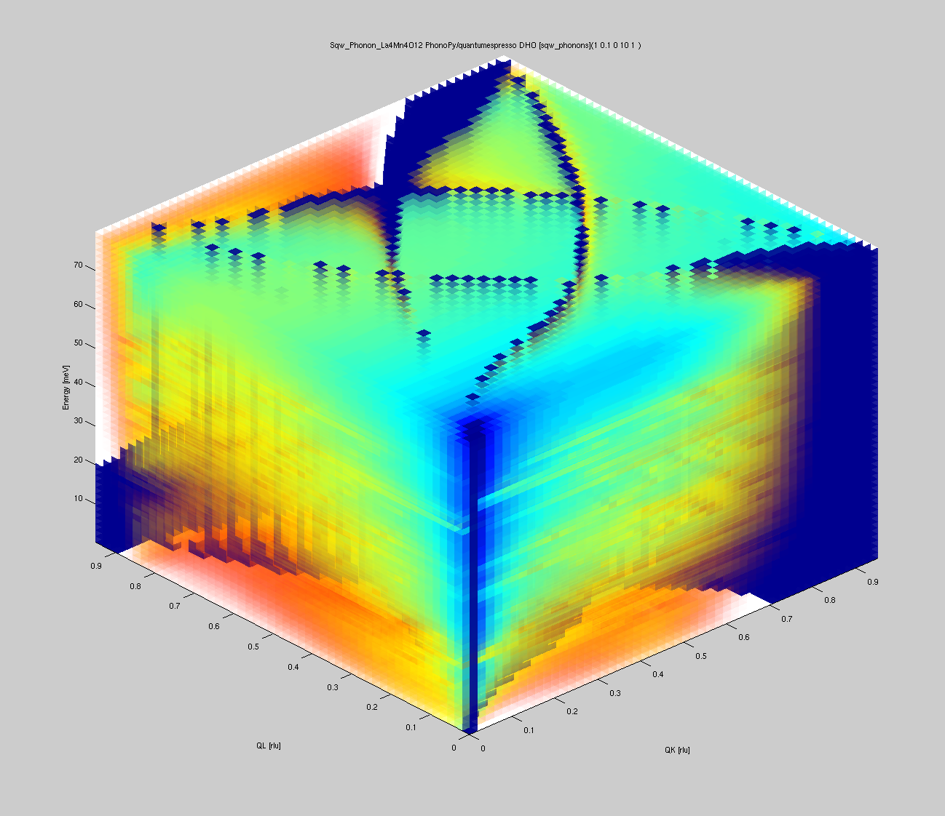
LaMnO3: Phonons
Calculation done with QE:
  s=sqw_phonons(‘cod: La Mn O3’,’qe’) % 15 h, 24 cpus
Start Matlab/iFit:
  load LaMnO3
  disp(s) % a 4D model
  figure; plot3(s) % use contextual menu ‘invert transparency’
  slice(s)

Slide 13
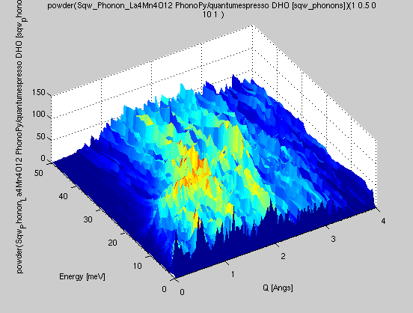
LaMnO3 → Sqw phonons coherent
Matlab/iFit:
  p=powder(s) % powder average model
  q=0.01:0.025:4; w=0:0.05:50;
  coh=iData(p,[ ], q , w);
  coh=iData_Sqw2D(coh);
  figure; plot(coh)
  saveas(coh, ‘LaMnO3_pow_coh.sqw’,’mcstas’)

Slide 14
LaMnO3 → Sqw incoherent
Matlab/iFit: with same (q,w) range as coherent.
  g=dos(s, w); % vDOS with coh ‘w’ values
  plot(g)
  inc = g.incoherent(‘q’, q, ‘m’, 242, ‘T’, 10);
  figure; subplot(inc)
  sinc = deBosify(plus(inc));
  ylim(sinc,[-0.15 50]); sinc{1}=w; sinc{2}=q;
  saveas(sinc, ‘LaMnO3_pow_inc.sqw’,’mcstas’)

Slide 15
LaMnO3: SpinWaves → Sqw
Create the spin-wave model:
  SW=sqw_spinwave('LaMnO3.txt','powder')
Evaluate on our axes:
  dSW=iData(SW, [], q, w); % SLOW (20 min)
  dSW=iData_Sqw2D(dSW);
  dSW.saveas(’LaMnO3_pow_sw.sqw’,’mcstas’)

Slide 16
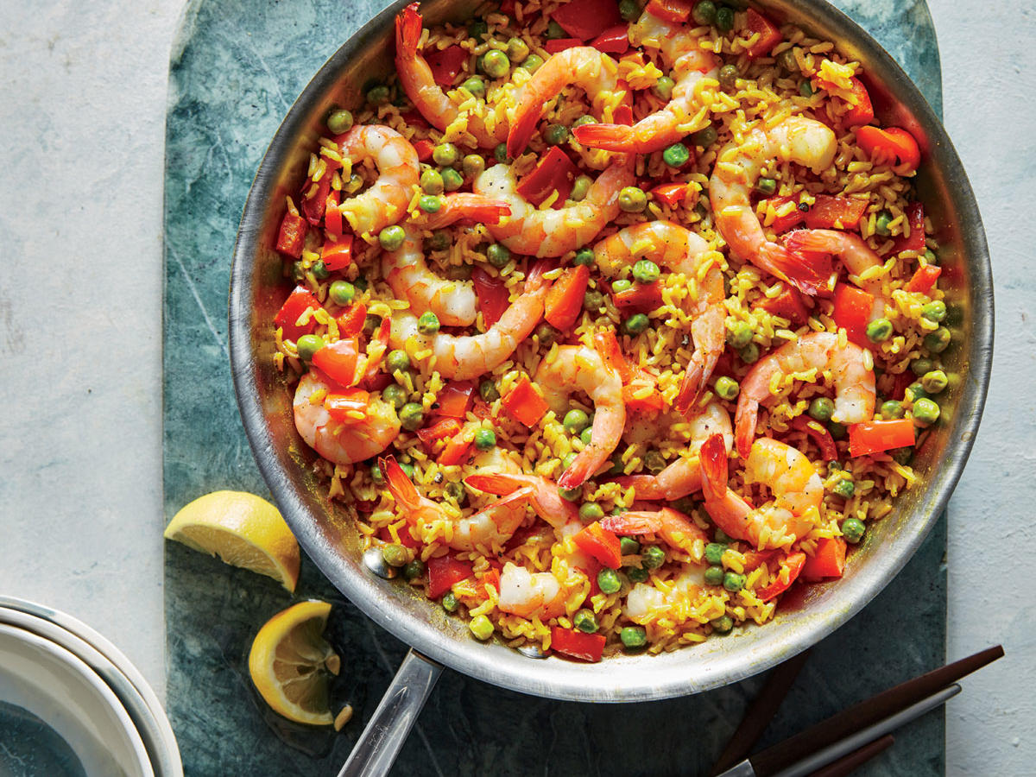
Now is the time to … mix

Slide 17
Check data files
Edit the LaMnO3.laz file. Something wrong ?
  Molar mass: 242 g/mol for LaMnO3
  s_{coh} = 23.0 barns / LaMnO3
  s_{abs}=22.3
  s_{inc}=1.53
  Density = 6.56 g/cm3
Check other files

Slide 18
Use LaMnO3 data files
We start from the templateTOF.
We remove the container, then add
  Isotropic_Sqw(Sqw_coh=”coh”, Sqw_inc=”inc”, norm=1)
  Isotropic_Sqw(Sqw_coh=”sw”, norm=1)
  PowderN(reflections=”laz”)
Sqw: T=-1 (no detailed balance), and norm=1 (data files as is).

Slide 19
S classical – S quantum
S*(q,w) = S(q,w) e^{-hw/2kT}
If T=10 K ~ 1 meV, and w ~ 30 meV
  e^{-hw/2kT} ~ e³⁰ = 10¹³ oups…
This is solved in iFit, but not in Isotropic_Sqw
  T=-1

Slide 20
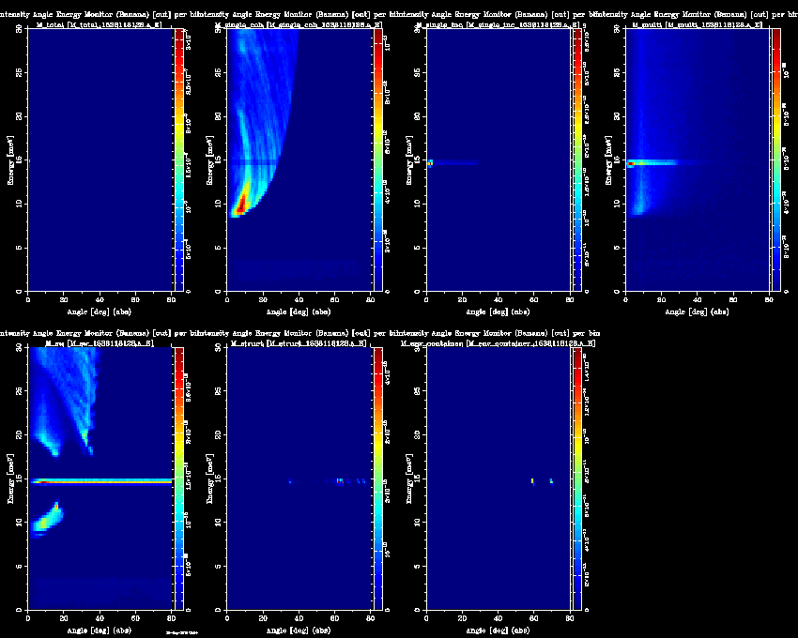
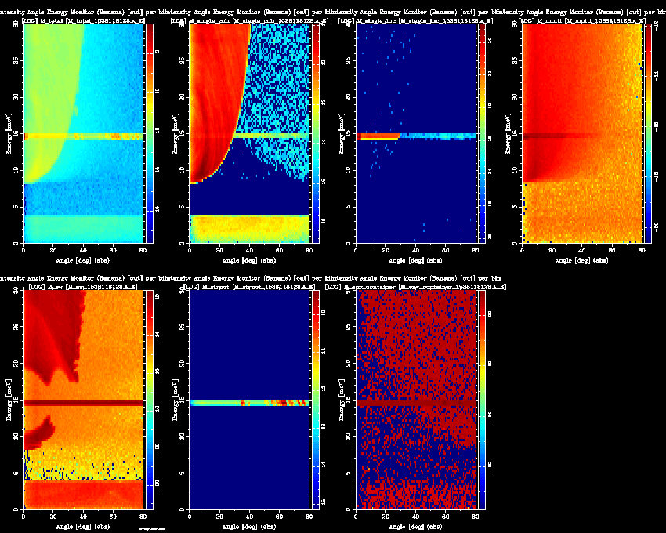
RUN !
templateTOF_LaMnO3.instr
ncount=1e8. Takes 10 minutes.

